Slide 1

Software Design Flaws & its Impacts

Slide 2

Software Design Flaw - Definition
A design flaw is a fault, error, defect, mistake, imperfection found or introduced in any design and affects the appropriate functionality or constructability of the final design.
A flawed design can result in unstable and unusable products, services and environments.
A flawed design of a software has negative impact on quality in terms of maintainability.

Slide 3
IMPORTANCE
"When you can solve a problem at the [software] design phase, it automatically solves a bunch of problems later on in the stages," says Neil Daswani, who is with Twitter's security engineering team. It's very cost-effective to solve security at the design stage.
"Getting software designers and architects what they need to think about when building software is just as important as getting developers to think about bugs. Unfortunately, not much attention is paid to that."
Notes:
This slide is only for the trainer… You can display the poll from GTM and after the poll is taken, share the result, connect the poll result with the topic. Once done, you can hide the poll so that the PPT is visible.
I have created the poll in the GTM webinar.

Slide 4
A DESIGN PROCESS is an repeatable approach to creating designs. This may include steps such as requirements analysis, market research, workshops, design work, prototypes and delivery.
Keys to attain flawless design flow
DESIGN PRINCIPLES are guidelines that can be used to shape design. Principles may improve designs, make them more consistent and save time by providing a basic direction. Design principles are guidelines that can be used to shape design.
ARCHITECTURE is the planning, design and construction of buildings and other large structures. It includes elements of engineering and art. Architects may also require understanding of sustainability, culture, law, business, materials, physics and other sciences.
DESIGN THINKING is the practice of creating things, solving problems, making decisions, devising strategies and learning using human design talents.

Slide 5
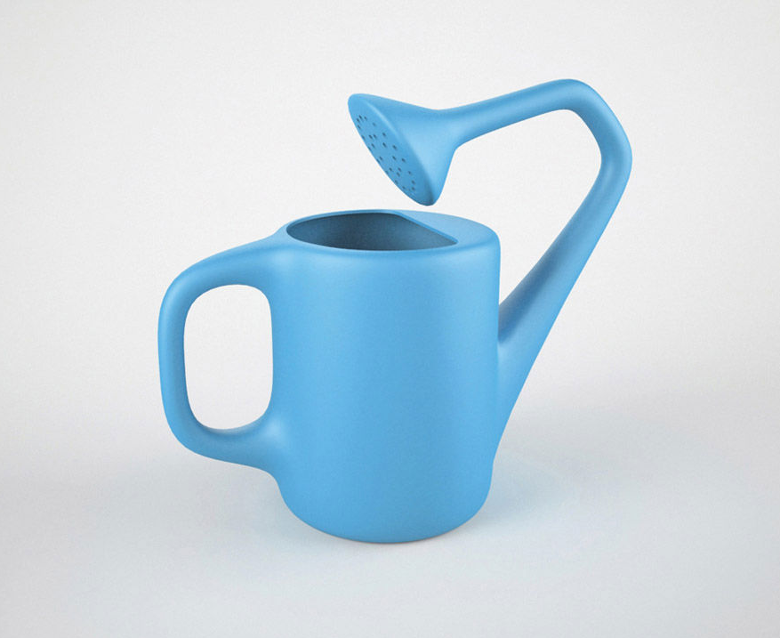

DESIGN FLAW
FLAWLESS DESIGN
IMPACT
IMPACT

Slide 6
To prevent the software design flaws:
Earn or give, but never assume, trust.
Use an authentication mechanism that cannot be bypassed or tampered with.
Authorize after you authenticate.
Strictly separate data and control instructions, and never process control instructions received from untrusted sources.
Define an approach that ensures all data are explicitly validated.
Identify sensitive data and how it should be handled.
Always consider the users.
Understand how integrating external components changes your attack surface.
Be flexible when considering future changes to objects and actors.

Slide 7

Impacts of Design Flaws
Rework will be required frequently.
It will create dependency issues.
Debugging will be a painstaking process.
Synergy of the team will be affected.
Satisfaction of the Customer will be affected.
Hard to repair and maintain the product.
Loss of revenue.

Slide 8


